Slide 1
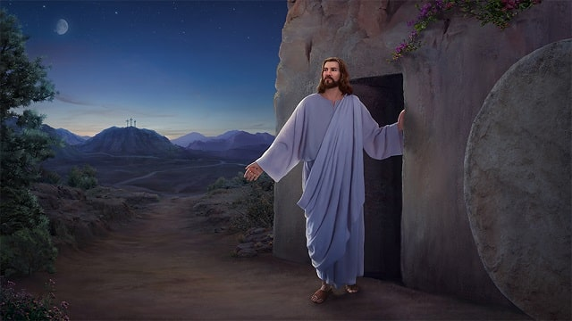
He Came Back
Mark 16:2-7

Slide 2
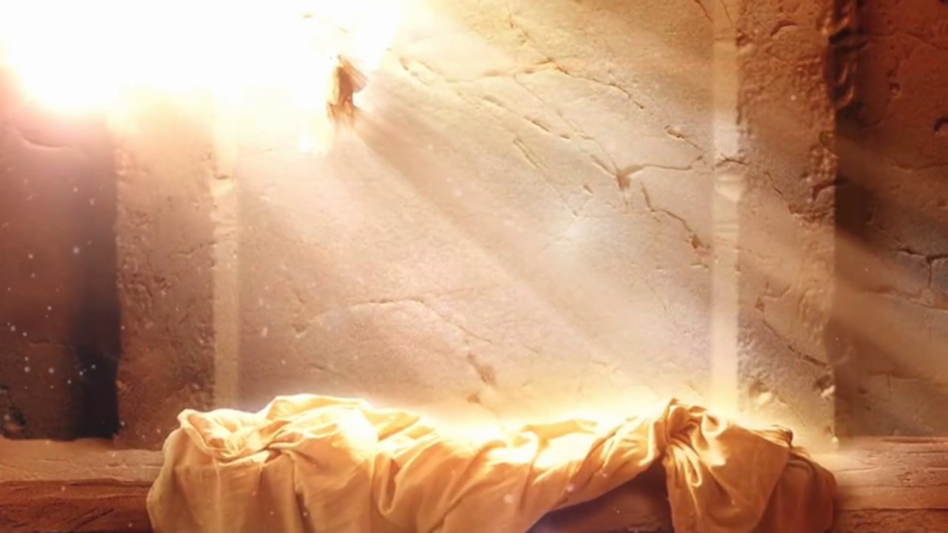
Vs. 2 – early in the morning on that Sunday …
Vs. 4 – the stone was rolled away
Vs. 5 – they walked in & saw the angel
Vs. 6&7 – came the hope of eternal life
He is going to Galilee and that is where you and the disciples will see Him
WHY GALILEE?

Slide 3
WHY GALILEE?
Came to His own Whom He LOVED
WHY ME?
WHY YOU?
Came to make you ONE of His own

Slide 4
The Good News Was & Is
He arose for them – He appeared to them
The Good News Was & Is
He arose for Us – He died for us – He appears to us

Slide 5
On That Friday
The disciples thought it was the end
On Sunday
The disciples found out it was just the beginning
HE CAME BACK!
CALL ON HIM – HE IS THERE FOR YOU!

Slide 6
World’s Four Major Faiths
# 1 Judaism – their founder Abraham is dead
# 2 Buddhism – their founder Buddha is dead
# 3 Islam – their founder Mohammed is dead
# 4 Christianity – their founder Jesus is alive

Slide 7
How Do I Know Personally?
Because He Came to Me!
Have You Allowed Jesus
To Come To You?
Welcome Him, He is as close as
the calling of His name

