Slide 1

Luke 10:30-37

Slide 2
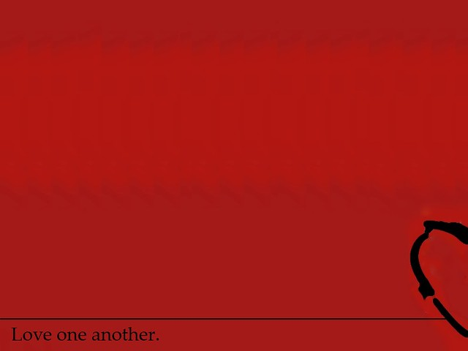
1st – Traveling a Dangerous Road
Road from Jerusalem down to Jericho
Our journey through life
1 Peter 5:8
Be sober, be vigilant; because your adversary the devil, as a roaring lion, walketh about, seeking whom he may devour:

Slide 3
2nd – The Victims
“A certain man”
You can place your name there or the
name of another
Luke 22:31
And the Lord said, Simon, Simon, behold,
Satan has desired to have you, that he may sift you as wheat.

Slide 4
3rd – The Non-Concerned
“A certain priest”
- saw him & passed by on the other side
“A Levite”
- came over to where the victim was & also passed by on the other side

Slide 5
4th – The Unlikely Hero
“A Samaritan”
Jesus asked,
Which one was this man’s neighbor?

Slide 6
TAKE-HOME THOUGHT
“Go and do likewise”

