Slide 2
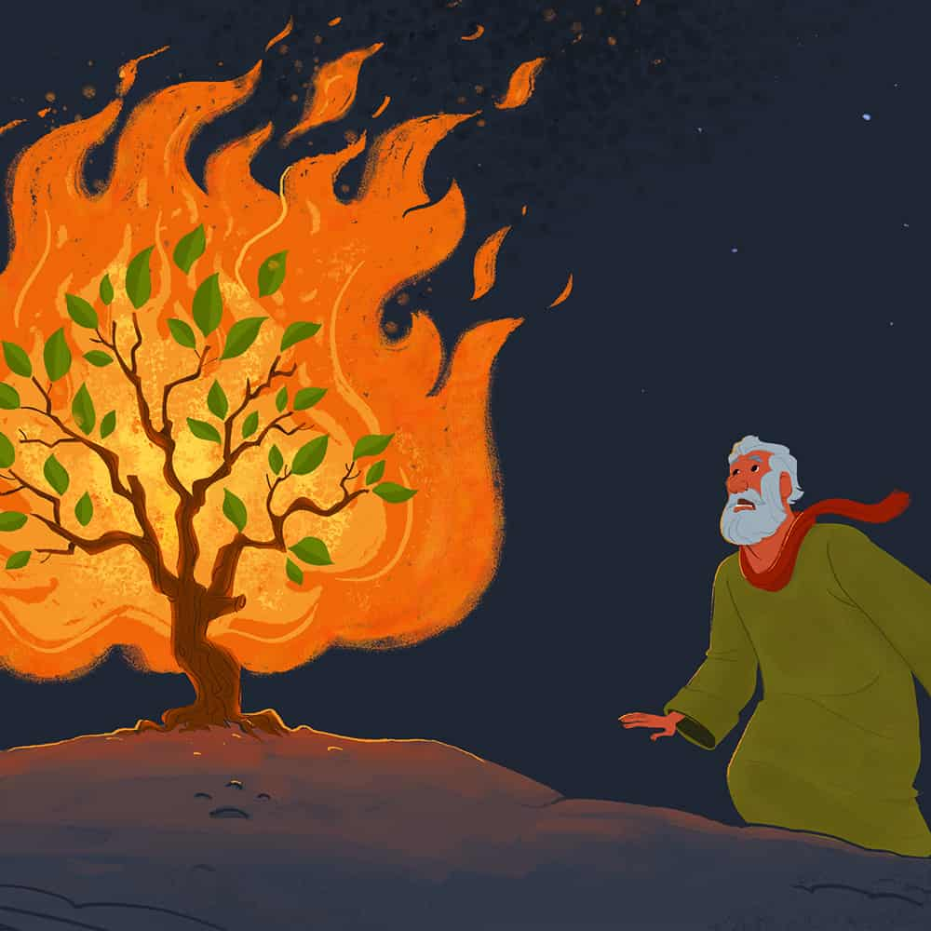
“The Light in the Wilderness”
The Burning Bush
Exodus 3:1-6

Slide 3
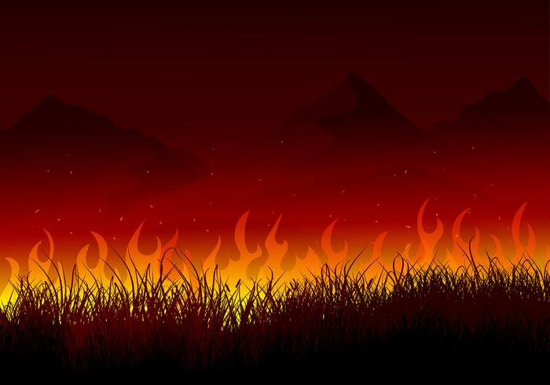
The Desert is Where Moses Meet God
The Wilderness (desert) Preceded Moses’ Devine Encounter.
Iron Must go Through the Fire to be Strengthened.

Slide 4
Rom 5:3-5
And not only so, but we glory in tribulations also: knowing that tribulation worketh patience; And patience, experience; and experience, hope:
And hope maketh not ashamed; because the love of God is shed abroad in our hearts by the Holy Ghost which is given unto us.

Slide 5
Moses Went to the Place Set Apart by God
Called the “mountain of God”.
Called “holy ground”

Slide 6
Ps 122:1
I was glad when they said unto me, Let us go into the house of the LORD.

Slide 7
Moses Turned Toward God’s Voice
Vs. 3 – I will turn to see.
James 4:8 – Draw nigh to God.

Slide 8
When Moses Turned Toward God, God Turned Toward Moses
Vs. 3 – When the LORD saw that he turned aside to see …
James 4:8 – Draw nigh to God and He will draw nigh to you.

Slide 9
Matt 11:28
Come unto me, all ye that labour and are heavy laden, and I will give you rest
God is calling you to Him!..

Slide 10
Moses Answered When God Called
Vs. 4 – Here am I
Moses reverenced God – hid his face / took off his shoes on holy ground

Slide 11
God Empowered Moses With All He Needed
Vs. 13-14 – . . . And God said unto Moses, I AM THAT I AM . . . Say unto the children of Israel, I AM hath sent you.
“I don’t know what to say.”
“I don’t have the ability.”
“Send someone else.”

Slide 12
Heb 12:1-2 . . . Wherefore seeing we also are compassed about with so great a cloud of witnesses, let us lay aside every weight, and the sin which doth so easily beset us, and let us run with patience the race that is set before us, Looking unto Jesus the author and finisher of our faith; who for the joy that was set before him endured the cross, despising the shame, and is set down at the right hand of the throne of God.

