Slide 2
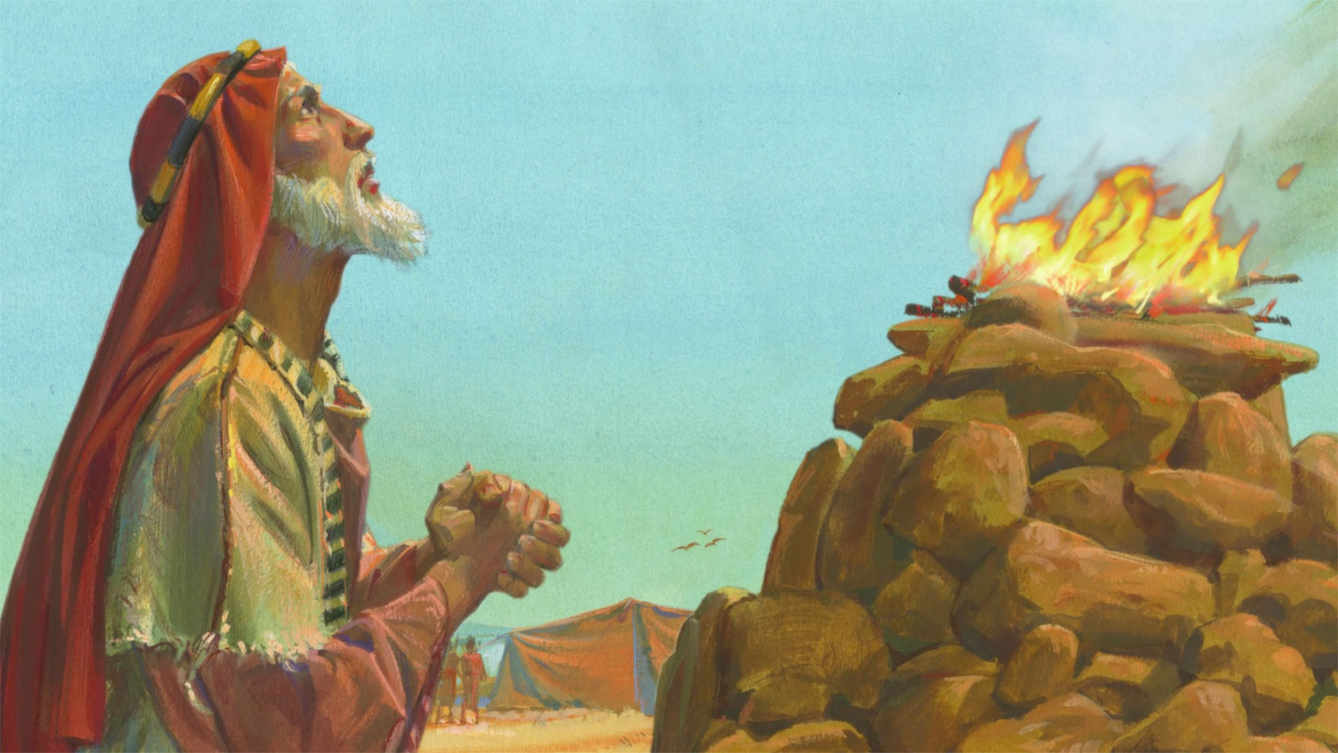
“The Fire at the Altar of Sacrifice”
Genesis 22

Slide 3
The Certainty of the Call (vs. 1)
No doubt the call came from God
No doubt this demand was a trial of faith
Questions Arise:
1. Is God sovereign?
2. Is God all knowing?
3. Is it possible this trial of faith is needed for
Abraham’s benefit?

Slide 4
James 1:3-5
Knowing this, that the trying of your faith worketh patience. But let patience have her perfect work, that ye may be perfect and entire, wanting nothing. If any of you lack wisdom, let him ask of God.

Slide 5
II. The Compelling Urgency in This Call (vs. 2)
“Take your son”
Don’t put off the call of God
Heb. 3:15
Today is ye will hear his voice, harden not
your hearts

Slide 6
III. God’s Supplication in This Call (vs. 11-13)
A divine encounter begins with lighting the fire.
Because you were willing to do what I ask - - - give up your most valued possession --- your son
God will offer a substitute – provided a lamb!
Personal Questions: Are you …
1. willing to go all in for God?
2. willing to say, “Lord, its not about me, but you?
3. willing to give yourself to gain more of God?

Slide 7
GO TO A NEW TESTAMENT ALTAR OF SACRIFICE
Rom 12:1-2
I beseech you therefore, brethren, by the mercies of God, that ye present your bodies a living sacrifice, holy, acceptable unto God, which is your reasonable service.
And be not conformed to this world: but be ye transformed by the renewing of your mind, that ye
may prove what is that good, and acceptable,
and perfect, will of God.

Slide 8
Summary:
See the certainty of God’s Call
Understand the urgency of God’s call
Receive the supplying from God in the call.
Let the change begin in you by . . .
Turn away from the conformity to the world
Be transformed (changed) in something good
for God

