Slide 1
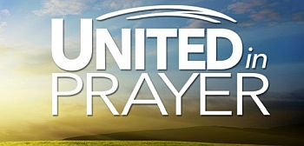
Acts 1:12-14

Slide 2
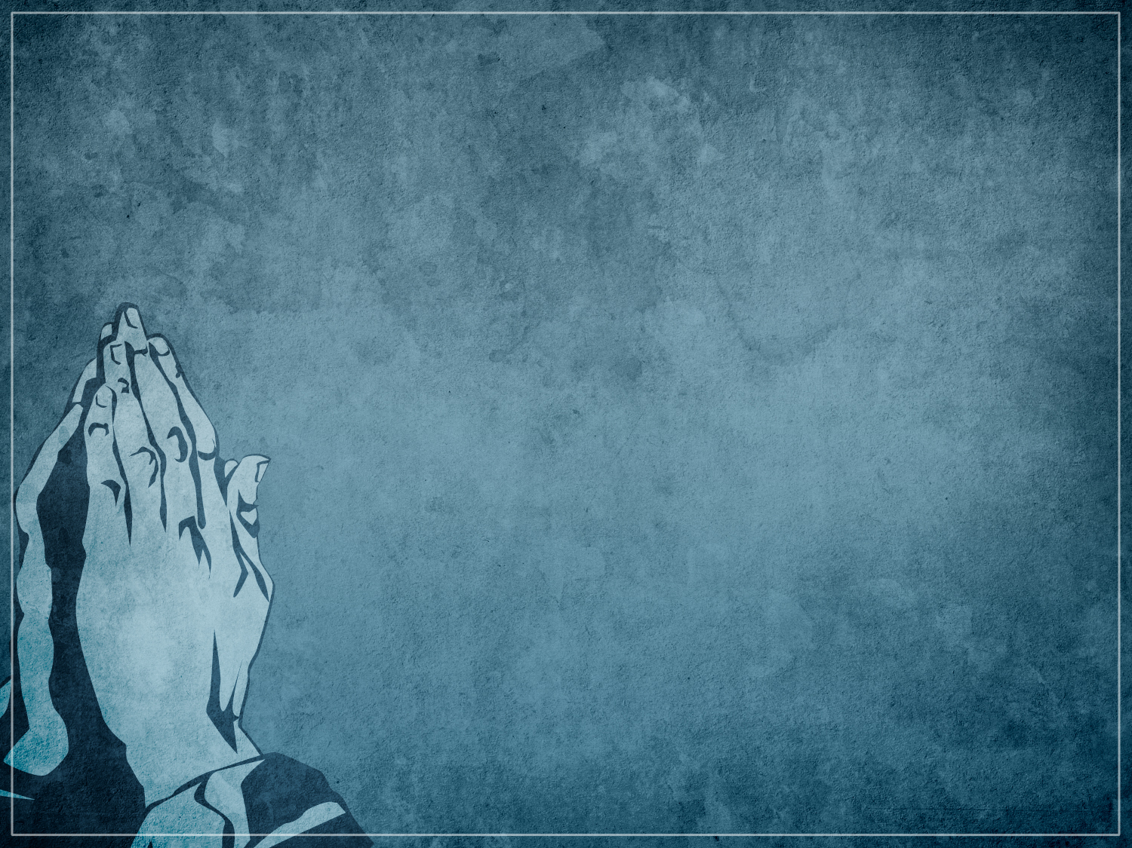
Who the “They” Were
120 Believers
Takes Believers to Pray

Slide 3
2. Where “They Were From
Mt. Olivet
- after having seen Jesus
Went to the Upper Room
- Where they had spent time
with Jesus

Slide 4
3. What “They” Were Doing
Were Praying
Were Praying in “One Accord”
- In Unity

Slide 5
3 Important Dates
March 7, 1981 – at Fellowship Baptist Church
August 2, 1990 – Beginning of Desert Storm
September 11, 2001 – 9/11 attacks

Slide 6
2 Chron 7:14-15
14 If my people, which are called by my name, shall humble themselves, and pray, and seek my face, and turn from their wicked ways; then will I hear from heaven, and will forgive their sin, and will heal their land. 15 Now mine eyes shall be open, and mine ears attent unto the prayer that is made in this place.

Slide 7
United Prayer Begins With . . .
God’s People
A Humbling
Praying
Seeking God’s Face
Turning from Sin

Slide 8
4. What Were The Results
Acts 2:1-2

Slide 9
Historically – Just a Couple Times in History
09/23/1857 “THE SECOND GREAT AWAKENING”
02/03/1970 – “THE JESUS MOVEMENT”

Slide 10
WE NEED A PENTECOST EXPERIENCE!
WE NEED A GREAT AWAKENING!
WE NEED A JESUS MOVEMENT!
WE NEED GOD IN AMERICA AGAIN!

